Slide 1
Level 1 Speaking & Listening Exam
Aims of the session:
To review the Level 1 Speaking and Listening exam.
To discuss ways, you can prepare for the exam.

Slide 2
Types of tasks
Task 1: Listening
Recorded text with 9 questions
Task 2: Everyday conversation
2-4 learners speak informally to each other then formally to the interlocuter.
Task 3: 2 -4 learners.
Presentation, questions and discussion.
(a process or a sequence)

Slide 3
Task 1: Listening
1.1 Follow the gist of a verbal communicationi on straightforward topics.
1.2 Obtain relevant detail from verbal communication on a straightforward topic.
1.3 Follow verbal instructions correctly for a given purpose.

Slide 4
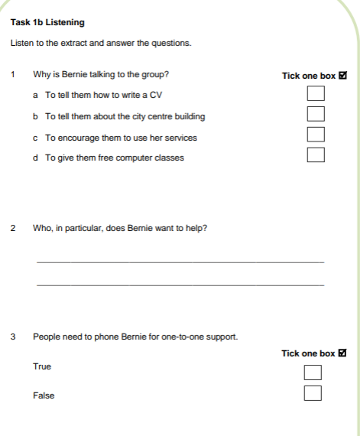
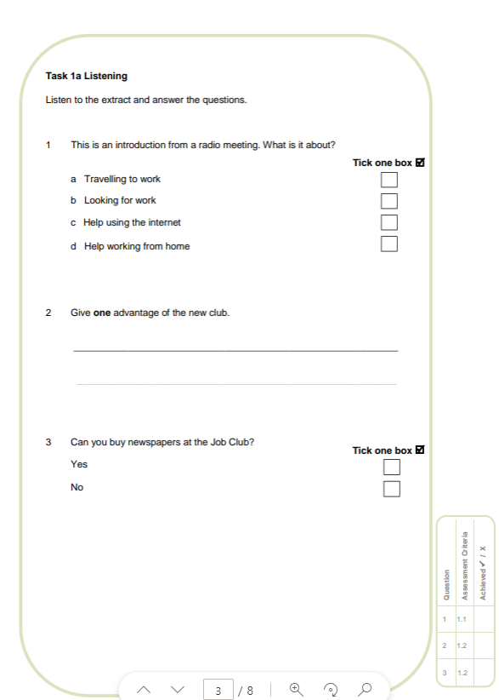
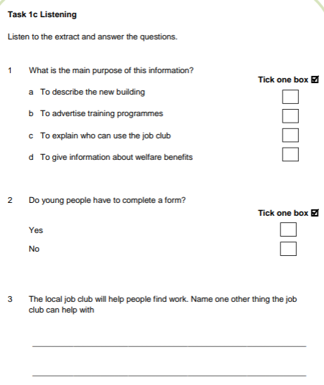
Task 1 Listening: You will listen to three recordings on the same topic e.g. starting a new job and answer nine questions.

Slide 5
Task 1 You will listen three times to each recording. There are two types of questions. Multiple choice, where you choose your answer and detail questions, where you write your answer.

Slide 6

Listening
Your tutors will ask you to complete lots of listening activities independently.
Use this as an opportunity to practise!
Please discuss how you are going to practise for the listening part of the exam.

Slide 7

Level 1 Task 1:
Listening - Test-English
Listening | LearnEnglish (britishcouncil.org)

Slide 8
Task 2: Everyday Conversation
Everyday Conversation at Level 1 is a group exercise. You do NOT know the topic before the exam
There are two situations – one informal and the other formal, however there are 3 sections !

Slide 9
What do you need to do?
You will assume roles as e.g., classmates or flat mates and chat about a mutual problem informally.
Then you need to plan who is going to say what in the formal part (one may describe the problem, one may suggest a course of action, and one may summarise and reach an agreement).
This is to evidence assessment of criteria 4.3 “Plan action with others for a given task”.
You will then take the problem for a formal conversation with the assessor who takes the role of e.g., head teacher or landlord.

Slide 10

Role–play Task 2 a
Informal
You live in a shared house with your classmate. There are several problems with the property, so you have arranged a residents’ meeting to discuss them and form a plan of action.
Formal
You meet with your landlord to discuss the problems and suggest some solutions. Your assessor will take the part of the landlord.

Slide 11
Review Task 2: Three parts!
1 Discuss the issue together. Give and ask for opinions. Agree and disagree and give lots of examples that support your points. Don’t just talk about your personal situation. Think about the bigger picture!
2 You are going to take your concerns to a senior person so summarise your thoughts. Decide who will introduce the group, who will then describe the issues and who will say what your group would like to happen.
3 Use FORMAL language! Make sure you all have the opportunity to speak.

Slide 12
Group conversation
Your tutors will ask you to work together in different groups. Use this as an opportunity to practise! We cannot guarantee you will be with your friends in the exam!
Please discuss how you are going to prepare for Task 2.

Slide 13
Task 3
Task 3 Presentation, Questions and Group Discussion (2-4 learners)
Printed photo or artefact may be used as prop

Slide 14
Task 3: Presentation & Discussion
You are given up to four weeks before the assessment to prepare a presentation on a topic of your choice. The topic must be agreed beforehand with your tutor.
You cannot present on the same or similar topics to prevent unfairly advantaging/disadvantaging anyone. ( No recipes allowed)
For the presentation it is expected that you prepare and deliver your own work.

Slide 15
You can use your candidate paper to make notes as you listen to the other presentations, but you may not take any prepared notes into the presentation.
To pass you must give a structured account with an introduction, development, and conclusion – You also need to ask questions to the other candidates about their presentations.

Slide 16
Task 3 Presentation and Discussion
You will give a short presentation on a topic of your choice. The topic needs to be agreed with your assessor.
Suitable topics may include:
An explanation:
how to find a good mobile phone contract
how to repair something
how to build something
An account:
A story about something interesting that happened e.g. an embarrassing moment, a coincidence or an amazing adventure.
After your presentation, you will take part in a discussion about the topic with the other learners.

Slide 17
Presentation & discussion
Your tutors will ask you to prepare other presentations and video record you doing these. Use this as an opportunity to practise!
Please discuss how you are going to prepare for Task 3.

Slide 18
Finally
You will have lots of time in class to practise for the exam and you can help by giving each other support and encouragement.
Your tutors cannot listen and give you feedback on your presentation. However, they will give general feedback to the class as a whole, so please listen carefully to this!
You are not permitted to record your exam presentation on any device.

